Slide 1
Command Line Argument
by Sahil Sinha
Enrollment no.- A45605221020

Slide 2
WAYS TO RUN PROGRAM
Using IDE
By double clicking the exe file
Using Command line

Slide 3
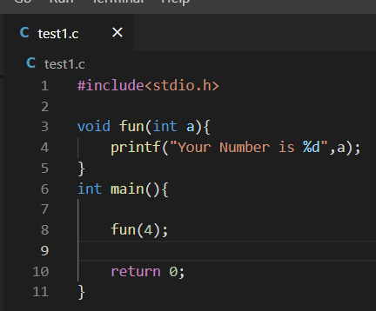
WHY TO USE COMMAND LINE?
In this code, there is a fun function which takes integer as an argument. To invoke/call this function fun, we also have to pass an argument as shown.

Slide 4
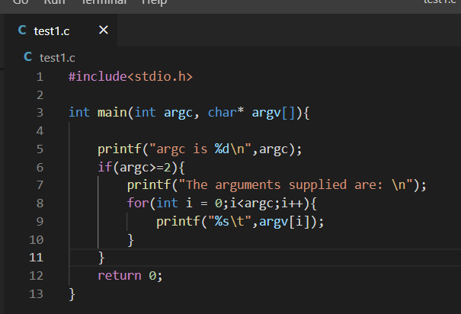
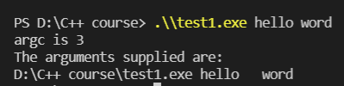
WHY TO USE COMMAND LINE?
Similarly, In this code main() is also a function and also take arguments.
Then how do we pass arguments to the main function,
To pass the arguments in main function, there is only one way and that way is running your program by using Command Line as shown below

Slide 5
WHAT ARE COMMAND LINE ARGUMENTS?
Command line argument is an important concept in C programming.
Sometimes we need to pass arguments from the command line to the program a set of inputs.
Command line arguments are used to supply parameters to the program when it is invoked.
It is mostly used when you need to control your program from the console.
These arguments are passed to the main() method.

Slide 6
THANK YOU

